Slide 1
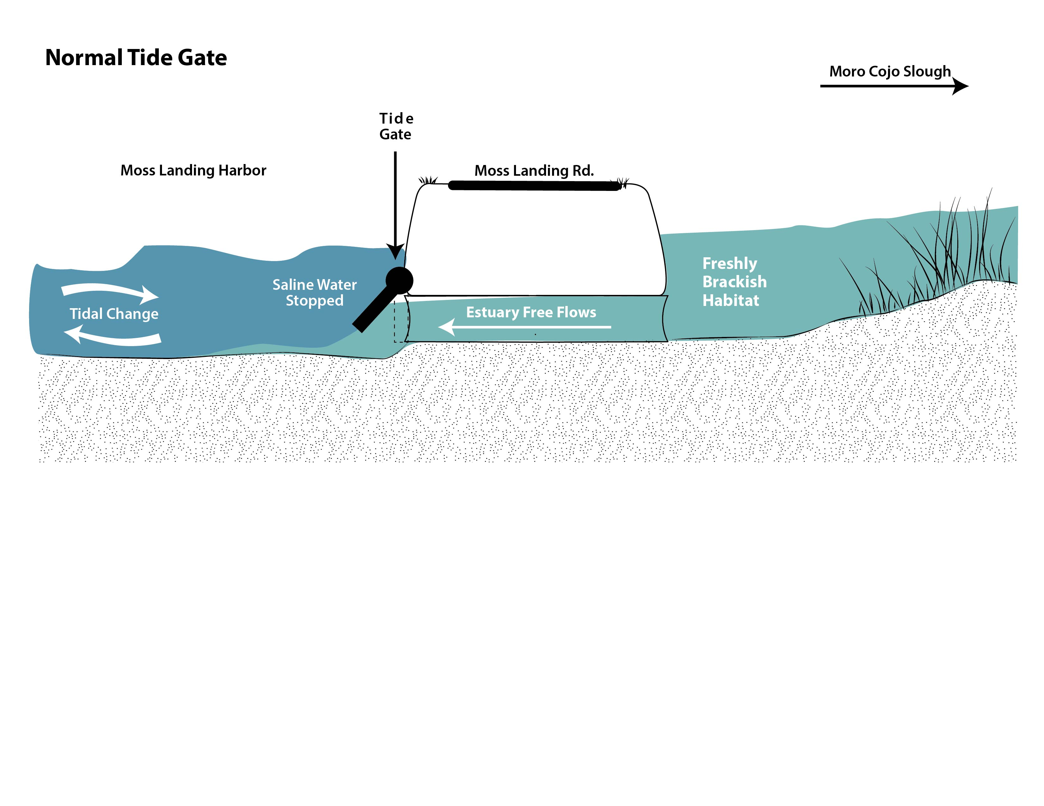
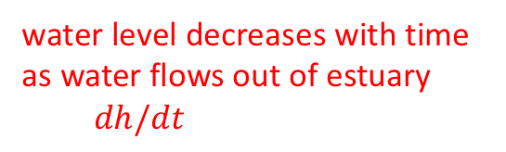
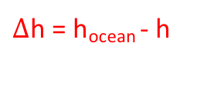
Water level and flow: schematic
1
15
Moss Landing harbor
Moro Cojo Slough
water level decreases with time as water flows out of estuary
$dh/dt$
h
water level
difference
$Δ$h = h_{ocean} - h
1
Flow Q [m³/s]
(negative out of estuary)
h_{ocean}
Adapted from Miranda Baker, illustration by Natalie Renier

Slide 2
Water level and flow: data
Monterey and Moro Cojo water levels
Rapid decreases in Moro Cojo water level during low tide in Monterey Bay
Spring-neap cycle, net inflow during periods of decreased tidal range every two weeks

Slide 3
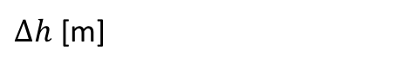
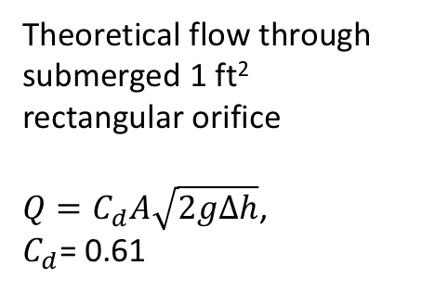
Water level and flow
ADCP data from summer 2016
Tide gate closed → weak inflow when ocean water level is higher than Moro Cojo
Planned repairs for a 12”x12” adjustable opening to allow inflow
Theoretical inflow based on USDA water measurement manual
https://www.usbr.gov/tsc/techreferences/mands/wmm
Effect of future repairs on outflow?
weak flow into Moro Cojo when ocean water level is higher
inflow
ouflow
Theoretical flow through submerged 1 ft² rectangular orifice
$Q=C_{d}A\sqrt{2gΔh}$,
$C_{d}$= 0.61
flow, Q [m³/s]
$Δh$ [m]
Ocean water level lower
than Moro Cojo
Ocean water level higher
than Moro Cojo

Slide 4
Comparison before and after initial repairs
Initial repairs resulted in decreased inflow and outflow
These data are used to develop models of water level in Moro Cojo, forced by ocean water levels
Dashed lines are the equations used in the model
Scenario A – failed tide gates (based on red data points, 2015)
Scenario B – initial repairs
(based on blue data points, 2016)
inflow
outflow
Ocean water level lower
than Moro Cojo
Ocean water level higher
than Moro Cojo

Slide 5
Model results: summer 2015
Comparing model scenarios for summer 2015 (before repairs)
If the model were perfect, the red and blue curves would look exactly the same (it is not perfect)
Model scenario B shows the effect that initial repairs would have had, if done immediately
Steady rise in sea level is associated with non-tidal ocean variability and occurs in both model scenarios

Slide 6
Model results: historical data

